Slide 1
Kontaktkonferansen 2012
På vei mot stjernene – hvor skal vi legge listen?
Ole Petter Ottersen,
Universitetet i Oslo
…og det er ikkje meir enn at vi på simpelt vis kan fø to kyr og ein gris. Og kyrne heiter Dagros, Fagros, gamle Fagros, Grisen heiter Giss, Giss, Giss.

Slide 2
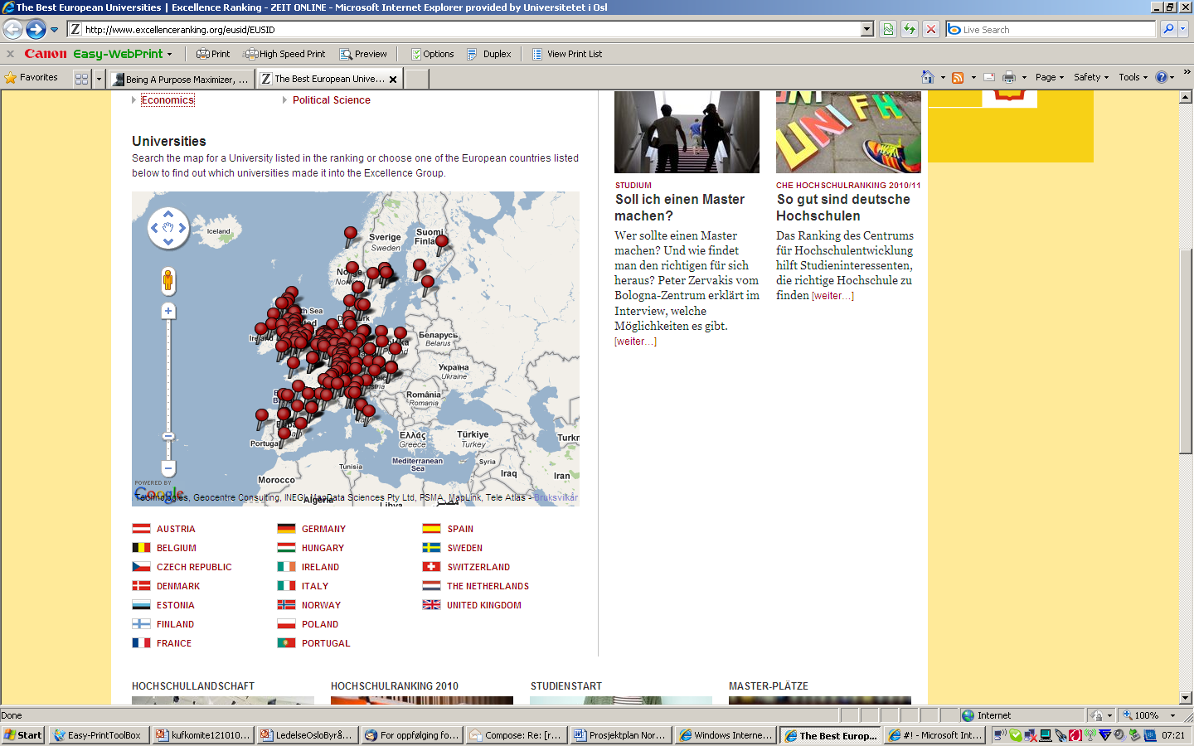
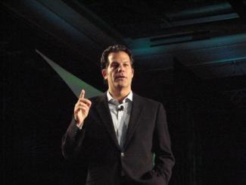
Richard Florida
Vi må kompensere for at vi er utenfor de store veikryss i Europa

Slide 3
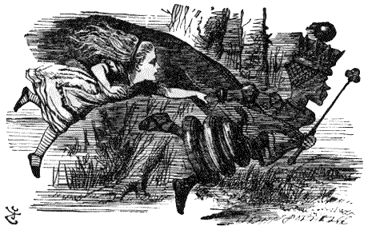
The “Red Queen” effect: do nothing and fall behind, or run hard to stay where you are.
…regardless of how well a species adapts to its current environment, it must keep evolving to keep up with its competitors and enemies who are also evolving
Universitetene er i en kontinuerlig moderniseringsprosess – drevet fra innsiden

Slide 4
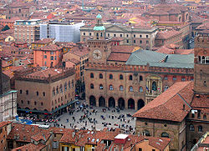
Aftenposten 2. september 2011
Universitetet i Bologna
”Internasjonalt har universitetsidéen vist en utrolig livskraft. Hvis vi gjorde en reise tilbake i tid til 1500-tallets Europa ville vi gjenfinne bare noen titalls av de institusjoner som fortsatt eksisterer i dag. Trekker man fra den romersk-katolske kirke, det engelske parlament og noen sveitsiske kantoner ville de fleste av disse institusjonene være universiteter.”

Slide 5
Notes:
Mer konkret kan det ikke bli.

Slide 6
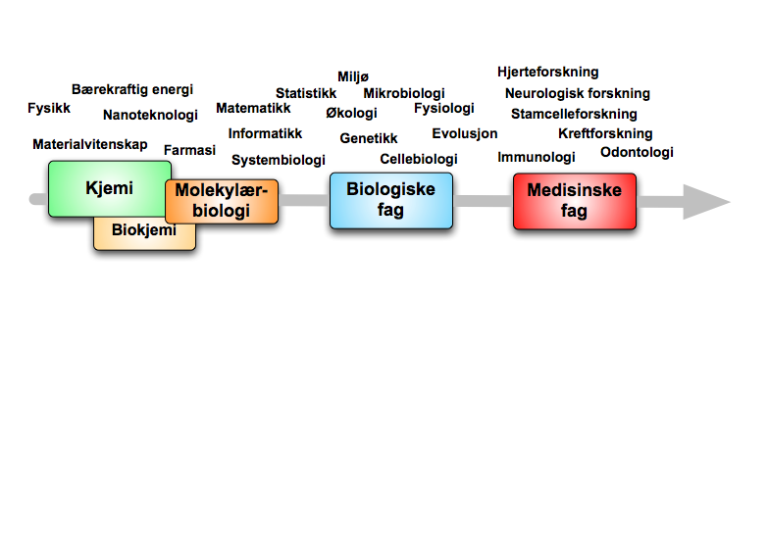
The entire value chain
Science
Faculty
Medical
faculty
«a comprehensive Life Science Cluster»
Health
Environment
Innovation
University
Society

Slide 7
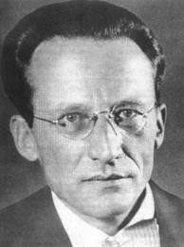
"The large and important and very much discussed question is: How can the events in space and time which take place within the spatial boundary of a living organism be accounted for by physics and chemistry?"

Slide 8
Hvorfor ambisjonene må være høye
As a funding source, the FPs play a minor role in the national research system. It is the overall size (total project costs) of the FPs activities Norwegians are involved in which really demonstrates the significance of EU research. In FP6, the total costs of all research projects with Norwegian participation surpass Norway’s total gross R&D expenditure (GERD) in 2007. (p. 138)

Slide 9
Universiteter med stor suksess i ERC er de som har rekruttert internasjonalt
Å søke stjernene: Internasjonalisering, basert på utdanning og forskning av høyeste kvalitet

Slide 10
The internationalization diagram
”North-South”
International
networking, EU
Recruitment
(students, researchers)
Institution Nation Globe

Slide 11
Er vi på vei mot stjernene?
UiOs 6 indikatorer
Utveksling/internasjonalisering
EU/ERC
Publikasjonspoeng
Studiepoeng
Gjennomføring PhD
Forskningsrådet
Sterk økning i ERC-grants over de siste år!

Slide 12
Forskningsmeldingen 2013
Tilbake til tallfestede innsatsmål – stole på institusjonenes egne resultatmål
Bruke handlingsromsrapporten som mal: modernisering fra innsiden avhenger av handlingsrom
Større vekt på internasjonalisering, inkl. internasjonale ”hubs”, mobilitet og repatriering (fra SAK til ISAK)

Slide 13
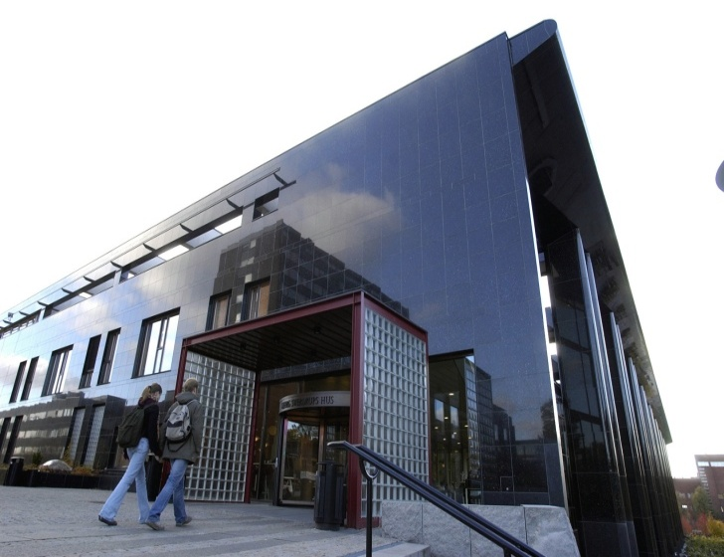
2012
Ambisjonene må økes!
Få andre land i Europa står foran en så radikal omstilling av arbeidslivet som Norge
Få andre land står foran en tilsvarende ”yngrebølge”
I den globale konkurransen om talent og ekspertise må Universitetenes attraktivitet kompensere for at vi er utenfor de store veikryss i Europa
Det er universitetene som må adressere de store nasjonale og globale utfordringene
Og glem ikke humaniora!

Slide 14
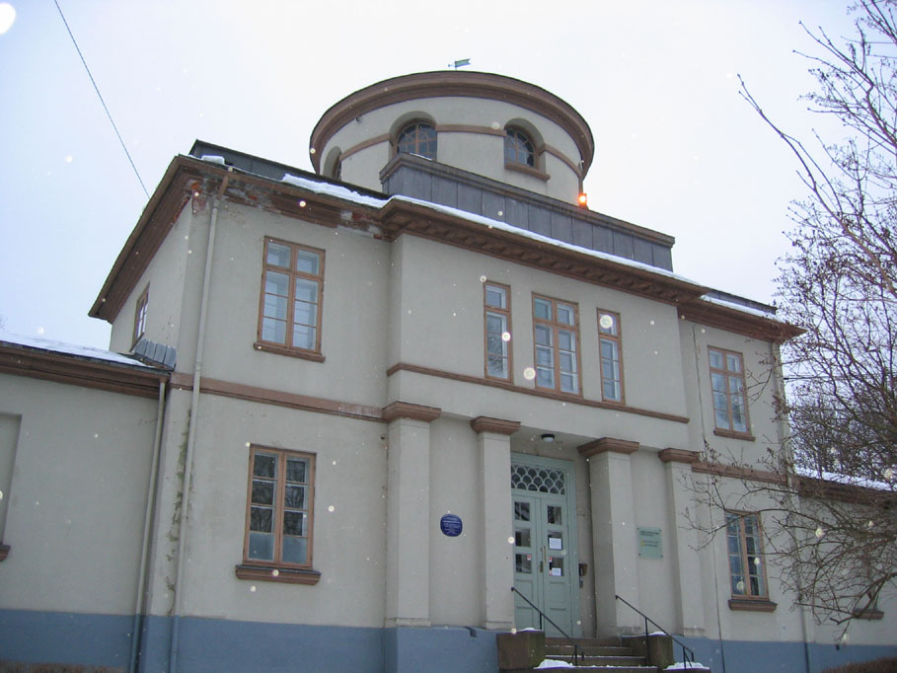
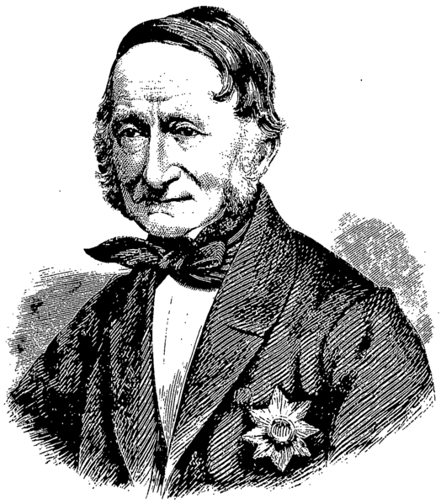
Observatoriet: Norges første universitetsbygning
”Et nos petimus astra”

Slide 15
Derek Bok: ”Universities share one characteristic with compulsive gamblers and exiled royalty: there is never enough money to satisfy their desires.”
The Economist, July 9th 2011
Cost cutting strategy (Vance Fried):
Separate the funding of teaching and research
Increase student-teacher ratio.
Eliminate programmes that attract few students
Puncture administrative bloat

Slide 16
Å søke stjernene gjennom internasjonalisering
Institutional: Maximize talent pool, increase external funding, prepare students for a global labour market
National: Build the ”new economy”, maintain competitiveness, get access to international expertise (NIFU)
Global: Accountable to the society at large, taking on the grand challenges, liaise with the realm of politics without losing autonomy or moving into scientism

Slide 17
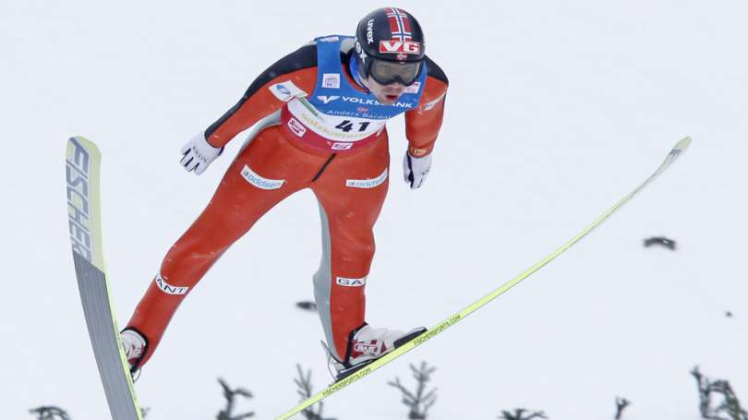
Modernisering fra innsiden:

Slide 18
Planning new premises for multidisciplinary Life Science including chemistry and pharmacy
An instrument for strengthening Norwegian Life Science,
spanning from chemistry to biomedicine,
- with Norways largest hospital as neighbor
- with Norways largest Department of informatics as neighbor
18

Slide 19
”Hvert Videnskabens, Literaturens og Kunstens Storværk er for et lidet Folk som vort et langt sikrere Værn for vor Frihed og vor Selvstændighed, end baade Armeer og Kanoner og Torpedoer og Panserskibe og Fæstninger”

Slide 20
The student body entering, participating in and completing higher education at all levels should reflect the diversity of our populations. (Bologna)

Slide 21
The idea of a university
Newman: “the diffusion and extension of knowledge rather than its advancement”
“To discover and teach are distinct functions; they are also distinct gifts, and are not commonly found united in the same person”
Newman er på vei mot kanonisering, men vi kan ikke ukritisk kanonisere hans idegrunnlag.

Slide 22
The idea of a university – continued
Humboldt: “The university teacher is thus no longer a teacher and the student is no longer a pupil. Instead the student conducts research on his own behalf and the professor supervises his research and supports him in it.”
Humboldt’s idea formulated in a period of crisis (defeats at Jena and Auerstadt): Looking for a new basis of values and a new idée force which could provide his nation with a foundation for restoration and new greatness. “Erziehung durch Wissenschaft.”
“The state must understand that intellectual work will go on infinitely better if it does not intrude.”

Slide 23
The idea of a university – continued
Vannevar Bush: “The pioneer spirit is still vigorous within this nation. Science offers a largely unexplored hinterland for the pioneer who has the tools for his task. The rewards of such exploration both for the Nation and the individual are great. Scientific progress is one essential key to our security as a nation, to our better health, to more jobs, to a higher standard of living, and to our cultural progress.”
Kerr: Multiversity “fired with enthusiasm”
“The University is so many things to so many people that it must, of necessity, be partially at war with itself.” (The uses of a university)

Slide 24
Universitetsidéen i Norge: fra nasjonsbygging til omstilling og ”sikkerhetsnett”
”Da handlingsregelen ble innført i 2001, ble det lagt vekt på at deler av det økte handlingsrommet som oljeinntektene gir, skulle brukes til å styrke den langsiktige vekstevnen til norsk økonomi, for eksempel gjennom investeringer i infrastruktur, forskning og utdanning. ”(…).
Geert Mak 2011: “Science and higher education is our society’s safety net and an antidote to consumerism.”

Slide 25
Hvordan startet universitetsidéen i Norge?
”Yrkesskole eller fullstendig universitet?”
Nicolai Wergeland: ”Uagtet Videnskaberne ere mangfoldige, udgjøre de dog kun eet Væsen.” Videnskaberne skal berige hverandre.
Newman: The fields of knowledge are ‘independent in themselves’, and each is supreme within its ‘own department’, requiring no higher or general authority; but they need each other to be whole, being used to reflect on each other. The different fields ‘complete, correct, balance each other’ . All contribute to the ‘atmosphere of thought that every student breathed, even though the student might specialize in only one or two areas’.
Peter Rokseths visjon for Blindern.
Capstone courses?
Arbeidsgiverundersøkelsen 2011: Arbeidsgiverne setter pris på bredde og evne til refleksjon. Arbeidsgivere vil i utgangspunktet alltid ønske seg en smalere kompetanse enn det som er optimalt for dem.

Slide 26
Research and teaching: an example of cohabitation?
This represented a major test for the hybrid Fifth Republic whose constitution allocates powers and responsibilities in a vague and sometimes contradictory manner between President, prime minister, and government. Cohabitation is essentially a conflictual relationship, but one involving a temporary collaboration where responsibilities overlap

Slide 27
How to deal with a university ”at war with itself”
Kandidatene er vårt viktigste ”produkt”
Vi skal velge det beste fra Newman, Humboldt og Kerr
Newman: ”collision of mind with mind”
Humboldt: ”student conducts research on his own behalf…”
Kerr: ”The Uses of the University”
Men ingen av disse forutså internett og globaliseringen: ”Before the horizon was the nation. Now it is the world.”
The new university is the ”global research university”

Slide 28
I et universitet ”at war with itself”, hvor skal vi definere frontene?
Øke økonomisk og strategisk handlingsrom
Rekruttering
Tverrfaglighet
Faglig fokus
Omdømme
Studiekvalitet
Internasjonalisering
Innovasjon
Verdier

Slide 29
Univ as Humboldts pillar in a society without army
Geert Mak
Safety net

Slide 30
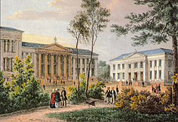
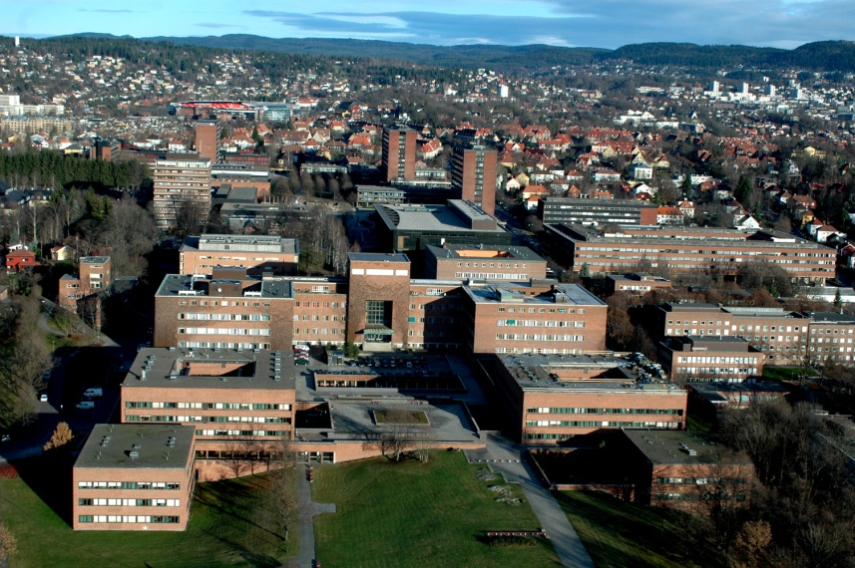
University of Oslo (UiO) in brief
Founded in 1811 - and antedating our constitution (1814)
Classical profile of research-intensive university
Comprehensive institution with 8 faculties and 2 museums
In close cooperation with 2 university hospitals
One of the largest universities in Scandinavia
27 000 students (incl. 2 700 at PhD level)
4 850 employees (incl. 2 200 academic staff)
Ranks 1st in Norway, 24th in Europe, 75th in the world (ARWU 2010)

Slide 31
The problem
UiO is a university that has expanded quickly, in response to societal needs and with little attention to internal synergies
This has led to a university with enormous thematic breadth and with myriads of tasks (including production units coupled to the DNA reform)
Driven by external forces, growth has led to fragmentation of research and disjunction between education, research, science communication and innovation
”We are not playing together - but alongside each other”
”Being responders to a variety of societal needs we find it difficult to build an institutional identity”
A paradox: The loose confederation created in response to societal needs cannot respond to the societal demand for control and accountability
A sad realization: The fragmented, discipline-oriented university does not live up to its potential in addressing current national and global challenges

Slide 32
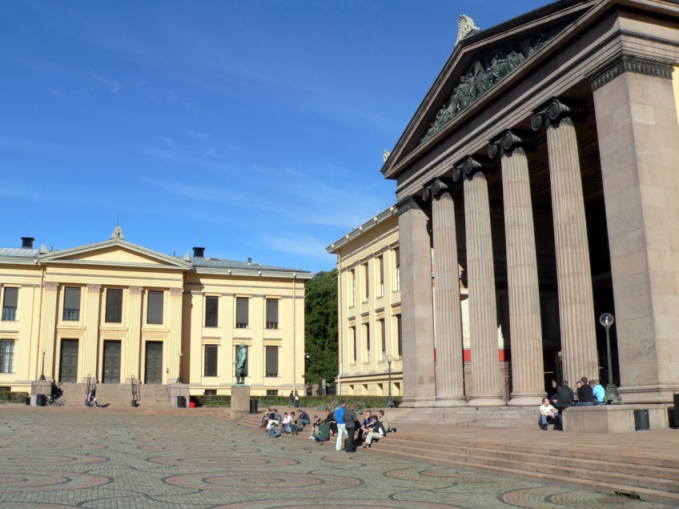
The way forward
Scale down and transform: not a viable option in current political landscape
Strategy of choice:
Conservative prioritization
coupled to
Capitalization on intra-institutional
diversity

Slide 33
Capitalization on intra-institutional diversity
Build good interdisciplinary and interfacultary research and study programmes
Couple education to the best research groups
Integrate science communication and innovation with education and research

Slide 34
Capitalization on intra-institutional diversity – the design of a new strategy plan
UiO Strategy2020 hot off the press
Long time horizon, to kindle creativity
An integrative plan with no breakdown on discipline or theme, no breakdown on task (education, research, science communication)
The result: a strategy plan that should foster interdisciplinarity, counteract disjunction and serve as an antidote to ”fragmentation”

Slide 35
Strategy2020: Five “universities” in one
A university transcending borders
A university for research-based education
A university in society
A university in action
The university of my choice
(Photo: Francesco Saggio)

Slide 36
What has been achieved thus far?
Interfacultary educational and research programmes
Centres of Excellence
Establishment of a leadership program that promotes interdisciplinarity

Slide 37
New multidisciplinary initiatives
7 Multi-Faculty priority research areas
Living conditions in developing countries
Life Sciences
Cultural processes in an age of global change
Religion in pluralistic societies
Multi-level democracy, constitutional government, democratic participation
Science, language arts and mathematics education; school leadership. Knowledge in and about schools.
Climate change in a legal, economic, geological and policy perspective
Fostering creativity at the interface between disciplines
Notes:
All these areas involve several disciplines across several faculties.
37

Slide 38
National Centres of Excellence (sponsored by the Research Council of Norway)
Medicine
Centre for Molecular Biology and Neuroscience
Centre for Cancer Biomedicine
Centre for Immune Regulation
Natural Sciences
Centre for Physics of Geological Processes
Centre of Mathematics for Applications
Centre for Ecological and Evolutionary Synthesis
Centre for Theoretical and Computational Chemistry
Center for Biomedical Computing
International Centre for Geohazards
Social Sciences and the Humanities
Equality, Social Organizations and Performance
- Confronting Theory with the Nordic Lessons
Centre for the Study of Mind in Nature
Injects physics into geology
Joins ecology with evolutionary biology
Notes:
The University of Oslo coordinates 8 of the 21 National Centres of Excellence and an major consortium partner in another 3 (in Italic).
38

Slide 39
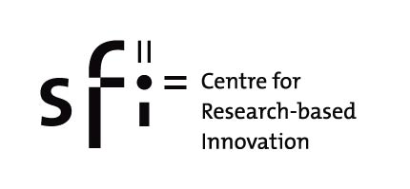
National Centres to develop expertise and promote innovation
Centres for Research-based Innovation
Innovative Natural Gas Processes and Products (UiO)
Information Access Disruptions (FAST asa)
Statistics for Innovation (NR)
Stem Cell Based Tumor Therapy (Oslo University Hospital)
Centres for Environment-friendly Energy
Research – CEER
BIGCCS Centre – International CCS Research Centre (SINTEF)
The Norwegian Research Centre for Solar Cell Technology (IFE)
Subsurface CO₂ storage – Critical Elements and Superior Strategy (CMR)
Notes:
Centre of Research-based Innovation:
The University of Oslo is home to 1 and
a major consortium partner in an additional 3 (Names in Italic)
of a total of 14 national centres.
Centres for Environmental-friendly Energy Research
The UiO is a major consortium partner in 3 (Names in Italic)
of 8 national centres.
39

Slide 40
Other incentives and drivers for interdisciplinarity
Upgrade interfacultary education
Internal mobility: ”Professors on the move”
Deans/vice rectors for interdisciplinary studies/research?

Slide 41
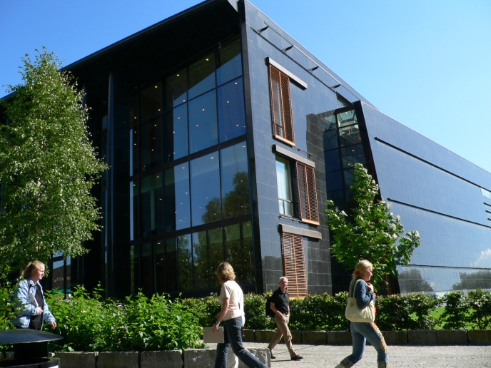
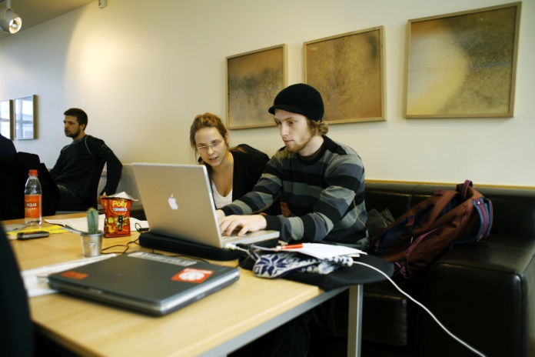
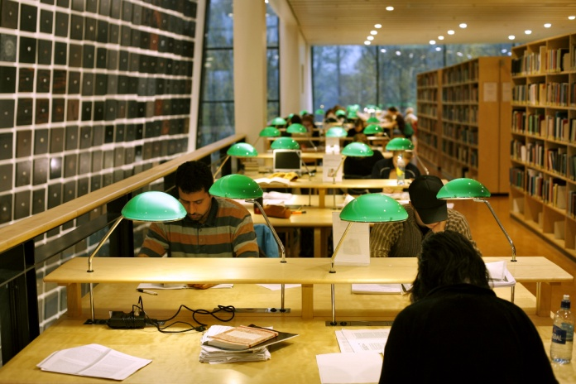
Capitalizing on intra-institutional diversity: the benefits
The need to address the global challenges has redefined the roles of universities and requires interdisciplinarity, interinstitutional collaboration and internationalization
The public and private sectors are facing the global challenges and request candidates that can help deal with them
The thematic breadth of universities should be well tuned to the complexity of the challenges ahead
Notes:
41

Slide 42
Capitalizing on intra-institutional diversity requires science polyglots
From polymath to polyglot
The polyglot shall be able to understand the language of other science disciplines and to thrive and excel in the new interdisciplinary, interinstitutional and international landscape
In an era when we should join to address common global challenges there is no need to remain in the safe haven of one’s own discipline
Getting out of the foxholes requires courage and stamina and appropriate incentives
Our new leadership programme is set to develop the polyglots that we now need

Slide 43
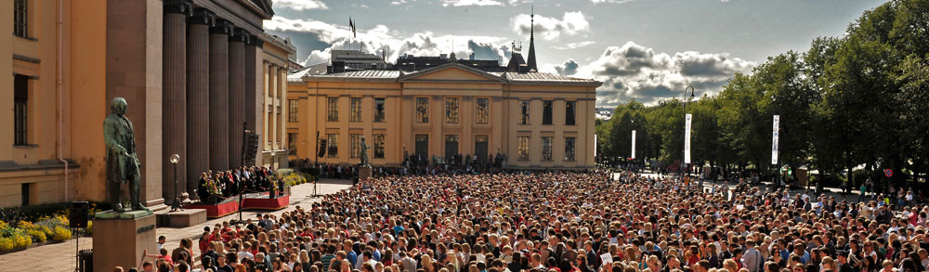
Internal vs. external diversity
Innovative exploitation of internal diversity can help profile the institution and make it stand out on the international scene
Nationally: Institutional diversity is constrained by predominance of earmarked vs. ”free” funds, and by legislation and accreditation criteria that promote convergence in the horizontal dimension
But the vertical diversity remains – creating a tension in the system

Slide 44
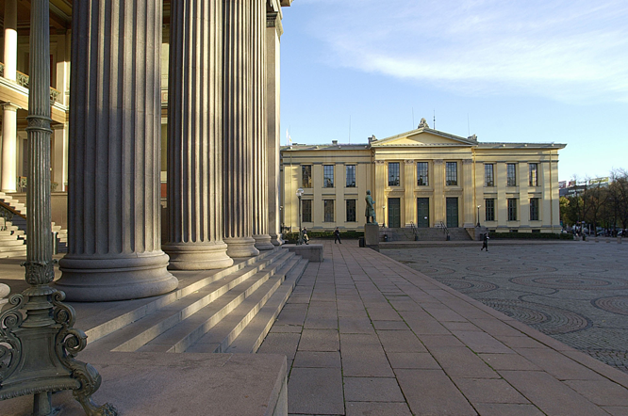
Thank you for your attention

Slide 45
”Hvert Videnskabens, Literaturens og Kunstens Storværk er for et lidet Folk som vort et langt sikrere Værn for vor Frihed og vor Selvstændighed, end baade Armeer og Kanoner og Torpedoer og Panserskibe og Fæstninger”

