Slide 1
Modernizing higher eduation – issues of access and learning
National Union of Students - Norway
Kim Orlin Kantardjiev

Slide 2
Formål og målsettinger med kampsakene
Access
(Morals)
Who enters, under what condition?
Who is left out and why?
Learning
(Quality)
How do students obtain values (and which values)
How do students obtain skills (and what skills)

Slide 3
The framework

Slide 4
Framing the question
“higher education institutions too often seek to compete in too many areas, while comparatively few have the capacity to excel across the board”
“There is no single excellence model: Europe needs a wide diversity of higher education institutions, and each must pursue excellence in line with its mission and strategic priorities.”

Slide 5
Choosing the colors or painting over the ugly parts?
Access, for who?
Access for quality
Drop-out still counts
The fix: Social inclusion

Slide 6
Now the motif…
New methods…?
Or research and development competency…?
And a small…

Slide 7
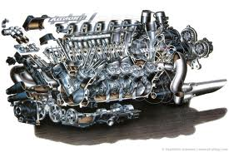
“In order to maximise the contribution of Europe's higher education systems to smart, sustainable and inclusive growth, reforms are needed in key areas”

Slide 8
Something about a triangle…

Slide 9
Thank you for your attention!
leder@student.no
Kim Orlin Kantardjiev

