Slide 1
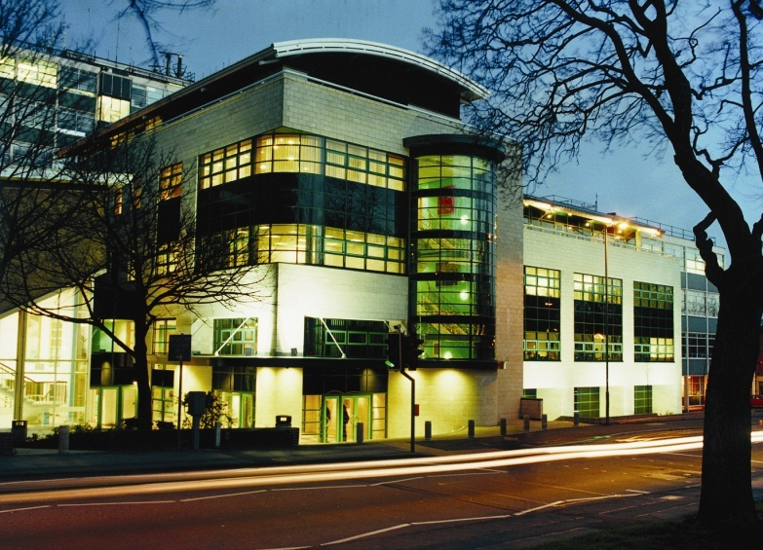
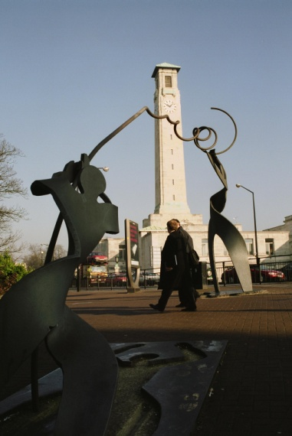
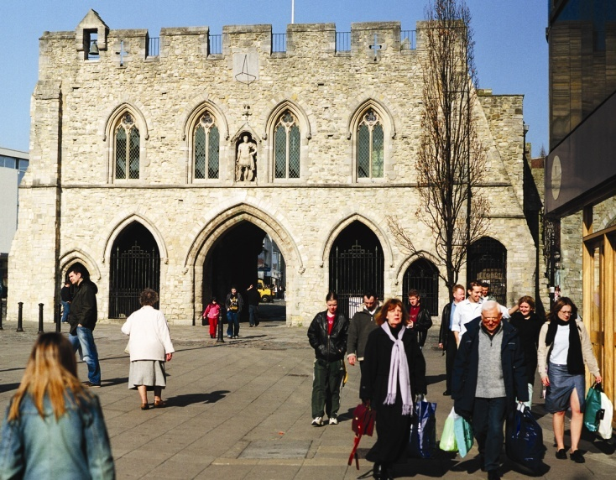
A learning partnership
Southampton Solent University and Norges Kreative Høyskole

Slide 2
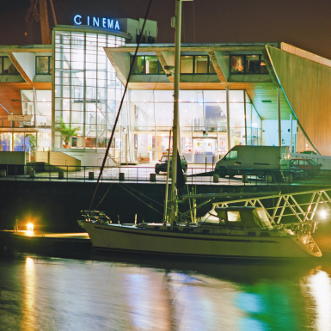
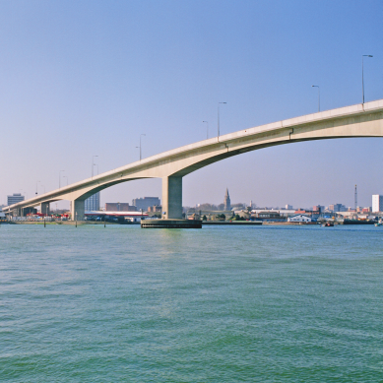
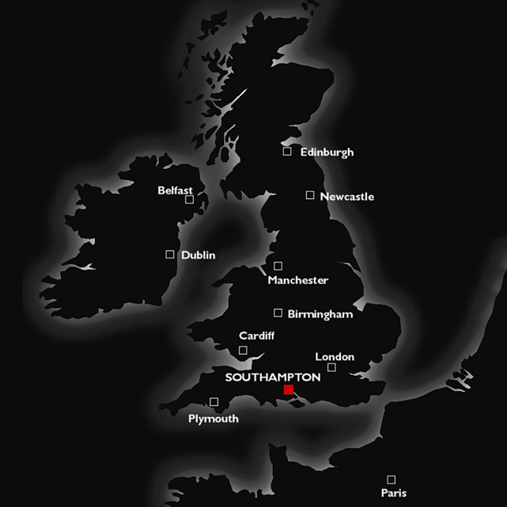
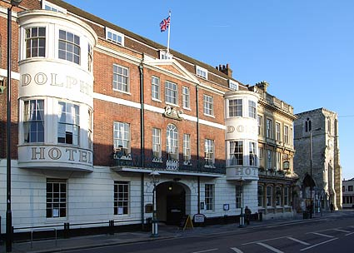
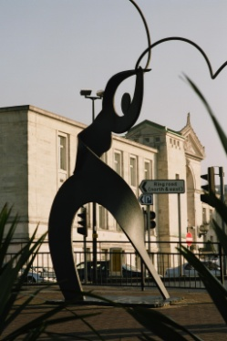
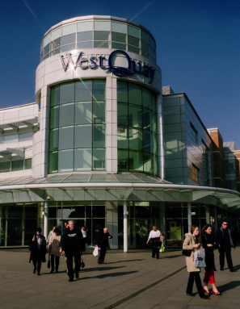

Where are we?

Slide 3

Undergraduate and Postgraduate courses
A wide range of courses
Over 140 full-time undergraduate courses
Art and Design Business and Law Shipping Accountancy Construction and Engineering Entertainment Technology | Yacht Design Media/Journalism Social sciences Sport and Tourism Popular Music

Slide 4
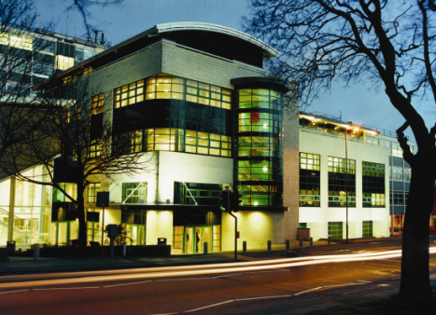
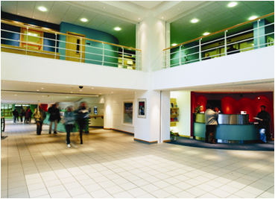
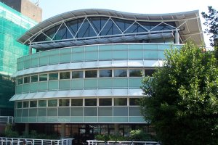
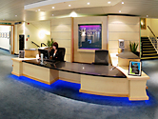
SSU and NKH
Progression Routes from SSU to NKH
Graphic Design
Photography
Animation
Interior Design
Illustration
Journalism
Music Design
Film
Advertising
In total an average of 70/80 students from NKH a year

Slide 5

Quality Assurance
Partnership Agreement
3 year life
Admission agreements
Overseas partnership Notification Statement (OPNS)
Direct entry
Portfolio, interview or essay
English levels

Slide 6

Academic transition from diploma to degree
Mapping-Curriculum 3 stages
1.Quality Assurance
2. International manager/course leader
3. SSU/NKH course leaders
  Focus on the marine service sector of shipping:
    For careers in Ship broking; Ship finance; Oil trading; Marine insurance, Port agency & Freight forwarding
MSC International Maritime Studies

Slide 7
Academic transition from diploma to degree
Mapping between academics
Teaching and learning outcomes of both course documents
Technology
Terminology
Industry communication
  Focus on the marine service sector of shipping:
    For careers in Ship broking; Ship finance; Oil trading; Marine insurance, Port agency & Freight forwarding
MSC International Maritime Studies

Slide 8
Academic transition from diploma to degree
Relationship between Academics
Building the Partnership/exchange
Joint exercises and visits
Workshops and lectures at
NKH and SSU
NKH student Visits to SSU
  Focus on the marine service sector of shipping:
    For careers in Ship broking; Ship finance; Oil trading; Marine insurance, Port agency & Freight forwarding
MSC International Maritime Studies

Slide 9
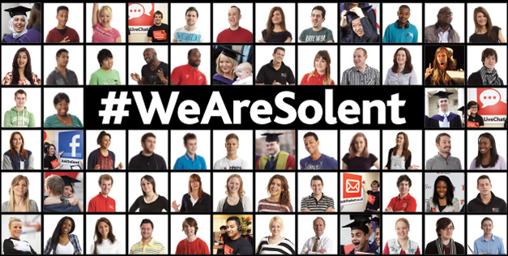
Vocation to Vocation
(post admissions)
Post Admissions – Induction
Induction-2 weeks prior to all students onsite
Meet the course team
Induction Project
Induction workshops
Support Systems
Assessments
  Focus on the marine service sector of shipping:
    For careers in Ship broking; Ship finance; Oil trading; Marine insurance, Port agency & Freight forwarding
MSC International Maritime Studies

Slide 10
Vocation to Vocation
(post admissions)
Post Admissions – in the classroom
Exchange of knowledge mapping student to student
Mapping Assessments
Mapping support systems
Student mentor systems
  Focus on the marine service sector of shipping:
    For careers in Ship broking; Ship finance; Oil trading; Marine insurance, Port agency & Freight forwarding
MSC International Maritime Studies

Slide 11
Vocation to Vocation
(post admissions)
Post Admissions – Post BA study
Portfolio building
Online Support
MA Study
Industry Exchange
Support Systems
Social networking
  Focus on the marine service sector of shipping:
    For careers in Ship broking; Ship finance; Oil trading; Marine insurance, Port agency & Freight forwarding
MSC International Maritime Studies

Slide 12

Successes and Challenges
Successes
NKH students work hard and perform well
Many graduate with 1st degrees
(100% pass rate on Interior Design Decoration.)
Student exchange of knowledge
Excellent employment figures
  Focus on the marine service sector of shipping:
    For careers in Ship broking; Ship finance; Oil trading; Marine insurance, Port agency & Freight forwarding
MSC International Maritime Studies
BA(Hons) Advertising graduates and D&AD 2012 winners Remi Lohne and Kim Thuen
(originally from NKF Bergen)

Slide 13
Successes and Challenges
Successes tutor collaboration
  Excellent working partnership
  Sharing of information
  Assessing levels of attainment
  Regular discussions on the profession
  Regular updates on industry standards
  Exchange of research
  Focus on the marine service sector of shipping:
    For careers in Ship broking; Ship finance; Oil trading; Marine insurance, Port agency & Freight forwarding
MSC International Maritime Studies

Slide 14
Successes and Challenges
Challenges
Research Skills
Time management
English
  Focus on the marine service sector of shipping:
    For careers in Ship broking; Ship finance; Oil trading; Marine insurance, Port agency & Freight forwarding
MSC International Maritime Studies
BA(Hons) Advertising graduates and D&AD 2012 winners Remi Lohne and Kim Thuen
(originally from NKF Bergen)

Slide 15
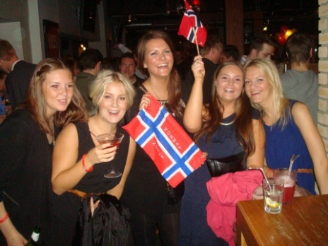
Extra activities at Solent
Solent Norwegian Society
www.solentnorwegiansociety.co.uk
Shared knowledge before students arrive
Creating a camaraderie amongst Norsk students

Slide 16
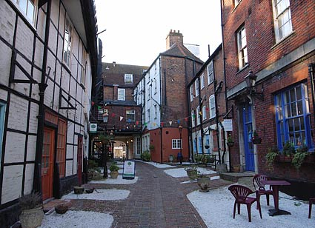

What works..
Exchange of knowledge
Continuity
Open systems of communication
Industry links

Slide 17
Thank you for listening
Questions?

