Slide 1
Proposed guidelines for application of offshore wind areas and licensing
Ministry of Petroleum and Energy
Oslo, June 22nd 2021

Slide 2
Agenda
Presentation of the licensing process
Grid-approach
The Ministry's assessment process
Questions

Slide 3
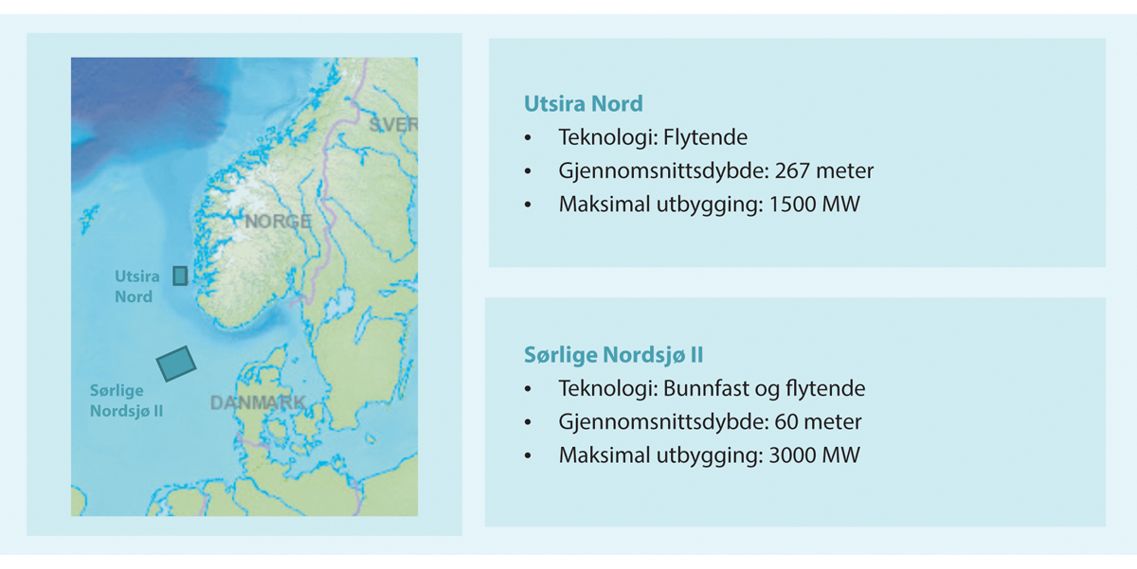

Slide 4

Award of areas
Two-stage process;
1. qualification-process
2. auction between the qualified companies/consortia
In special cases the Government may award areas based on qualitative criteria. An example of this exception is Utsira Nord
Announcement
Qualification
Auction/
competition
Award of areas

Slide 5
Qualification process
Technical competence
Financial capacity
Fulfil relevant requirements for health, safety and environment
Aims to ensure that the developer which is awarded an area is capable of developing a large scale offshore industrial project
Announcement
Qualification
Auction/ competition
Award of areas

Slide 6
Qualification process
Part II of the guidance note lists relevant documentation for the qualification process.
In the public consultation the Ministry asks for input on:
  Which field-specific expertise should developers posess?
  How should the Ministry facilitate the qualification process to allow for several developers to qualify as a consortium?
Announcement
Qualification
Auction/ competition
Award of areas

Slide 7
Auction process
The Ministry will develop an auction model suited for awarding areas for offshore energy development
The object of the auction is to award the exclusive right to develop offshore wind in a specific area
The Ministry is planning to conduct a public consultation before concluding on the auction model
Announcement
Qualification
Auction/ competition
Award of areas

Slide 8
Competition with qualitative criteria
The qualitative criteria should be objective and non-discriminatory
In the hearing, the Ministry ask for input on relevant criteria to most effectively create competition and stimulate gains in floating wind technology development in Utsira Nord.
The qualitative criteria will be described in the announcement of the competition
Announcement
Qualification
Auction/ competition
Award of areas

Slide 9
Award of areas
After the auction or the qualitative competition is concluded, the developers who have been awarded an area, will have 6 weeks to deliver a notice with a program for conducting an impact assessment
Announcement
Qualification
Auction/
competition
Award of areas

Slide 10

Grid-approach
The developers will plan, develop and finance the offshore grid infrastructure
The government will assess the various effects and legal aspects of hybrid projects in advance of an award of areas in Sørlige Nordsjø II
Statnett will be designated as the system operator offshore

Slide 11

The licensing process
When processing the license application, the Ministry will consider whether the benefits of the project outweigh the negative impacts on environment and society.

Slide 12

We welcome input in the hearing process
We specifically welcome:
  Feed-back on the model for awarding areas
  Suggestions for objective and non-discriminatory criteria to be applied in the qualitative competition. Specifically, with the goal of technology development of floating offshore wind.
  Which field of specific expertise should developers posess?
  How should the Ministry facilitate the qualification process to allow for several developers to qualify as a consortium?

Slide 13
Questions?

